Slide 1

Plastica Ltd
Fire Warden Training

Slide 2
Topics Covered
Daily Checks
Weekly Checks
Additional Weekly Checks
My Compliance App
Chain of Command in the event of a Fire or Drill
Fire Drill Tasks – Non-Chemical Fire
Fire Drill Tasks – Chemical Fire
Fire Drill Tasks – Chemical Fire – Outside Evacuation
Absence Cover
Fire Induction
Annual Barrier Test
Emergency Drills
Emergency Training
Reporting any Concerns

Slide 3
Daily Checks
Ensure that all Fire Exits are clear
Check for general hazards – fix anything you can e.g., remove cardboard from under stairs, remove blockages to call points, replace missing or worn-out signage
Report any issues using the My Compliance App

Slide 4
Weekly Checks in your area of responsibility
Check Fire Extinguishers are in place
Check Exit Lights are working
Check Fire Doors are in working order
All are numbered and checks will be registered on the My Compliance App
Report any issues using the My Compliance App

Slide 5
Additional
Weekly Checks
You will become responsible for checking the Emergency Lighting each week,
once we have the maps up to date
Report any issues using the My Compliance App

Slide 6
My Compliance App
All checks will be registered on the My Compliance App
Any actions will be sent by the App to the Fire Officers
Training to follow

Slide 7
Chain of Command in the event of a
Fire or Drill
In the event of a Zone 1-7 Non-Chemical Fire
Gate Fire Officer – in charge
Warden Fire Officer
Fire Wardens and other Fire Officers
In the event of a Zone 8-10 Chemical Fire
Reception Fire Officer – in charge
Warden Fire Officer
Customer Service Fire Officer
Fire Wardens and other Fire Officer

Slide 8
Fire Drill Tasks
Zone 1-7
Non-Chemical Fire
Immediately cease your work
Make machinery safe where possible
Check your area is evacuated, if safe to do so
Check the fire doors are closed, if safe to do so
Take the In and Out board, if not already taken
Report to your designated Assembly Point immediately
One Fire Warden to complete a check of personnel using the In and Out Board
One Fire Warden to report to the Gate Fire Officer, the outcome of the personnel check at the Assembly Point
Report any missing persons to the Gate Fire Officer as soon as possible
If someone is missing confirm to the Gate Fire Officer any areas you were not able to safely check
Return to your Assembly Point and ensure the personnel at your Assembly Point are aware of where to wait, remain calm and follow any given instructions
Remain at Assembly point until given further instruction by the Fire Service, Gate Fire Officer or Warden Fire Officer

Slide 9
Fire Drill Tasks
Zone 8-10
Chemical Fire
Immediately cease your work
Make machinery safe where possible
Advise personnel to evacuate through the building – if not dangerous to do
Advise all personnel to evacuate to the Customer Services Department
Check your area is evacuated, if safe to do so
Check the fire doors (and shutters) are closed, if safe to do so
Take the In and Out board, if not already taken, and safe to do so
Office Block Fire Wardens to ensure windows and doors are shut in Customer Services and the air conditioning is turned off – ensure this remains so throughout the evacuation
One Fire Warden to complete a check of personnel using the In and Out Board from your area
One Fire Warden to report to the Warden Fire Officer, the outcome of your personnel check
Report any missing persons to the Warden Fire Officer as soon as possible
If someone is missing from your In and Out Board check, confirm to the Warden Fire Officer any areas you were not able to safely check
Return to Customer Services and ensure the personnel from your area are aware of where to wait, remain calm and follow any given instructions
If told to evacuate outside, ensure all personnel are provided with an FFP3 mask and encourage them to be worn
Remain in Customer Services or at the external evacuation point until given further instruction by the Fire Service, Gate Fire Officer or Warden Fire Officer

Slide 10
Fire Drill Tasks
Zone 8-10
Chemical Fire
Outside Evacuation
If informed by the Fire Service, Warden Fire Officer or Reception Fire Officer that an outside evacuation is required:
You will be allocated a specific number of personnel, you are responsible for ensuring all arrive at our new Assembly Point
Calmly instruct your group to leave by the fire doors at the back of Customer Services
Our new Assembly Point is in the Tesco underground car park
Follow the Warden Fire Officer who will lead everyone to the assembly point.
Ensure you keep your group with you and ensure they safely cross any roads and advise the Warden Fire Officer on arrival that all of your group are together
Await further instruction from the Fire Service, Reception Fire Officer or Warden Fire Officer

Slide 11
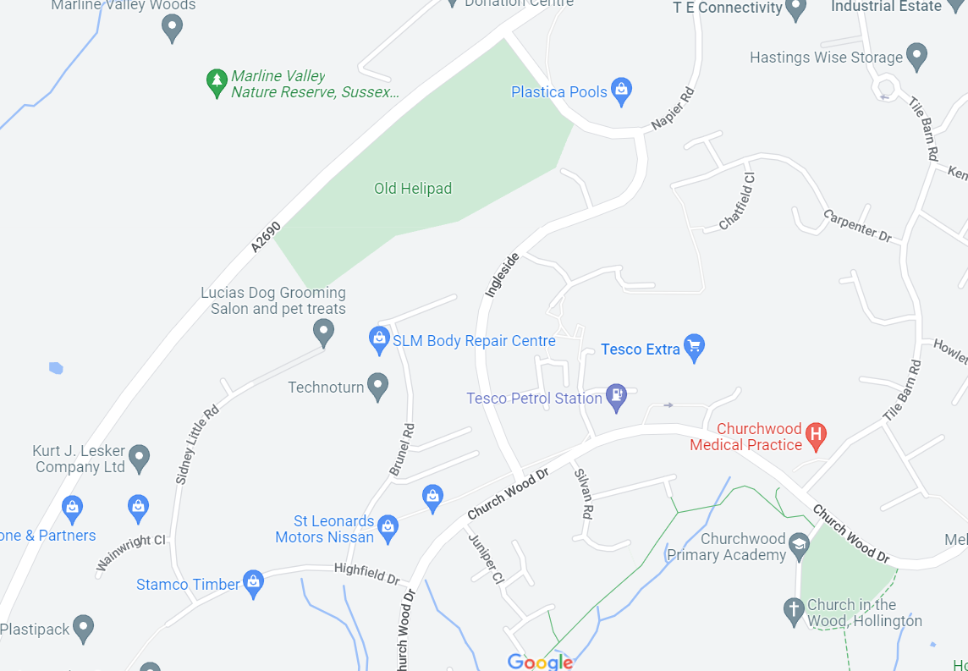
Outside Evacuation – Directions to Tesco Extra
We will walk through the pathways to the underground Tesco car park

Slide 12
Absence Cover
For pre-planned absence ensure you have arranged cover for your duties
For unexpected absence please ask your supervisor/manager to arrange cover

Slide 13
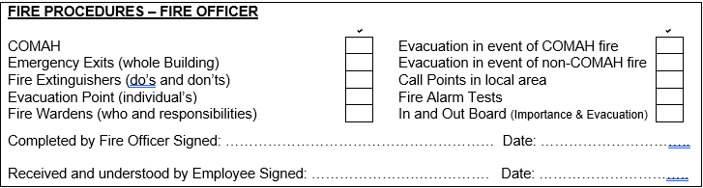
Fire Inductions
All new employees, both permanent and temporary must receive a Fire Induction during their first week of employment and as close to their first day as possible

Slide 14
Annual Barrier Test
We test our Barrier once a year, normally on a Thursday.
You will need to stay later that day to help with the test and learn how to deploy the barrier if you haven’t attended before
Dinner is provided!

Slide 15
Emergency Drills
We will be doing more Emergency Drills over the next few months to help train you in the new procedures
Standard drills will take place at least twice a year

Slide 16
Emergency Training
You will need to attend any emergency training that we arrange.
The first training will be with East Sussex Fire and Rescue Service – Fire Marshal / Warden Training.
It will be held here on site and take 3-4 hours

Slide 17
Reporting Any Concerns
All employees are required to:
Understand the Company’s Fire Safety Policy
Co-operate with the Company in complying with duties and requirements imposed by relevant statutory provisions and Company procedures
Co-operate with the Company in complying with fire safety management duties and requirements imposed by management
Not interfere with, or misuse anything provided in the interests of fire safety protection
Report all fire safety incidents to your manager/supervisor
We need you to ensure that your colleagues are following these requirements, advise them if they need to make adjustments to their behaviour and inform the Fire Officers if you feel there is still an issue

