Slide 1
Correct Load Containment
Tool Box Talk

Slide 2
WHY IT IS IMPORTANT TO LOAD CORRECTLY?
Every year in the UK alone over 4000 successful prosecutions for unsafe loads
Plastica’s spillage incident in 2015
Preventing further incidents for everyone’s safety

Slide 3
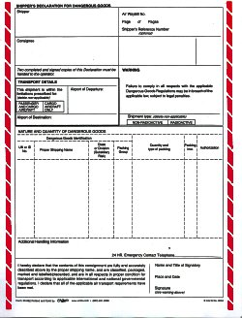
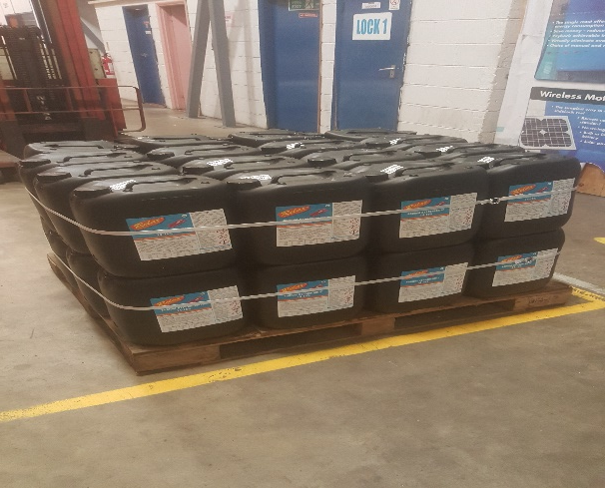
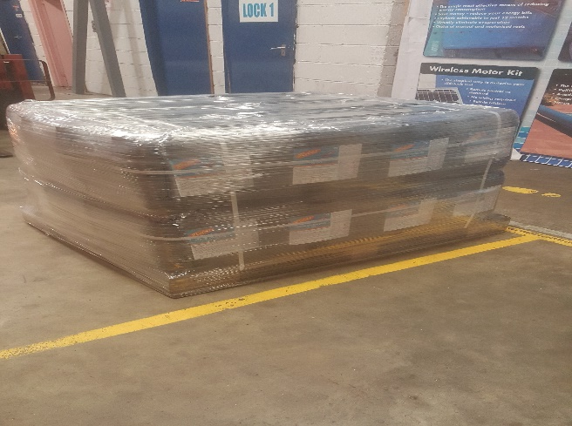
Assessing the Load
Condition of pallet
Straps
Load security on pallet
General condition of items on the pallet
Check paperwork for hazardous items
e.g. Dangerous Goods Notes

Slide 4
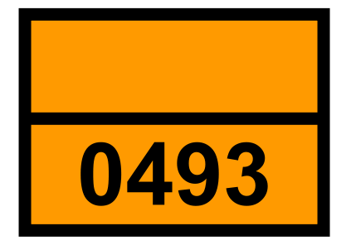
Check the Vehicle
Check with driver what is being carried and what is still to be collected
Check the vehicle is suitable to carry the dangerous goods
Check the bed of the lorry
Check for correct vehicle (axles)
Check the strapping
Check location of current load
Check if hazardous load, ADR equipment i.e. Hazchem plate
and fire extinguishers and PPE
Complete the ADR Check Sheet if load is hazardous

Slide 5
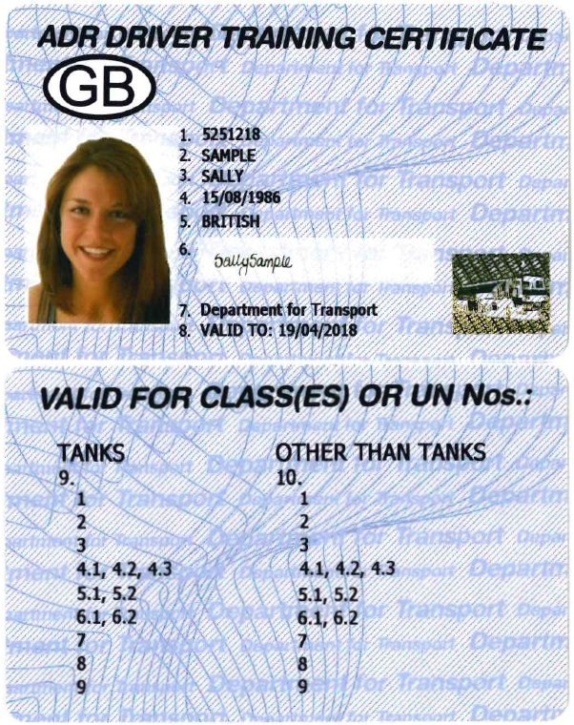
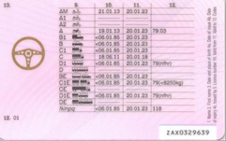
Check Driver Details
Check driving licence for permitted categories for new drivers
Check ADR licence(if hazardous loads) & new drivers – Valid To date and categories 5.1 and 8
valid to date
5.1
8

Slide 6
Check Weight and Distribution of Load
Check weight of whole consignment
e.g. don’t put 10 tonne of weight on one end of the lorry
Discuss with driver for loading preference
Joint responsibility to ensure loaded safely

Slide 7
LOAD SECURITY
Discuss with driver how load is secured
Check how pallets are strapped
Take photo of both sides of load and number plate with the Department camera for all hazardous loads

Slide 8
Refusing to Load
If you are not sure about the load/lorry/driver/paperwork discuss this with the warehouse manager or team leader who have the authority to refuse to load.
DO NOT REFUSE TO LOAD WITHOUT DISCUSSION WITH THEM

Slide 9
Summary
Assess the load
Check the vehicle
Check the driver details
Check weight and distribution of the load
Load security
IF IN DOUBT CHECK WITH THE WAREHOUSE MANAGER OR TEAM LEADER AT ANY STAGE

Slide 10
Questions?

