Slide 1
Safe loading of vehicles
Safety of loads
Stacking items on a pallet
Movement of load in transit and reasons why
Securing loads & strapping
Is the vehicle suitable for use
Placement of loads on vehicles
Extended loads and Markers
Unloading vehicles

Slide 2
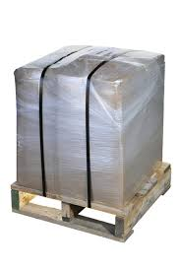
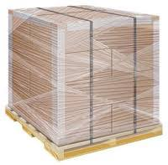
Safety of loads
Make sure items are secured to the pallet by strapping or shrink wrap
Shrink wrap must cover the base of the pallet and be tight enough to hold the items to the pallet
whilst in transit
Shrink wrapped pallet
Secure Strapping
Side supports added if needed

Slide 3
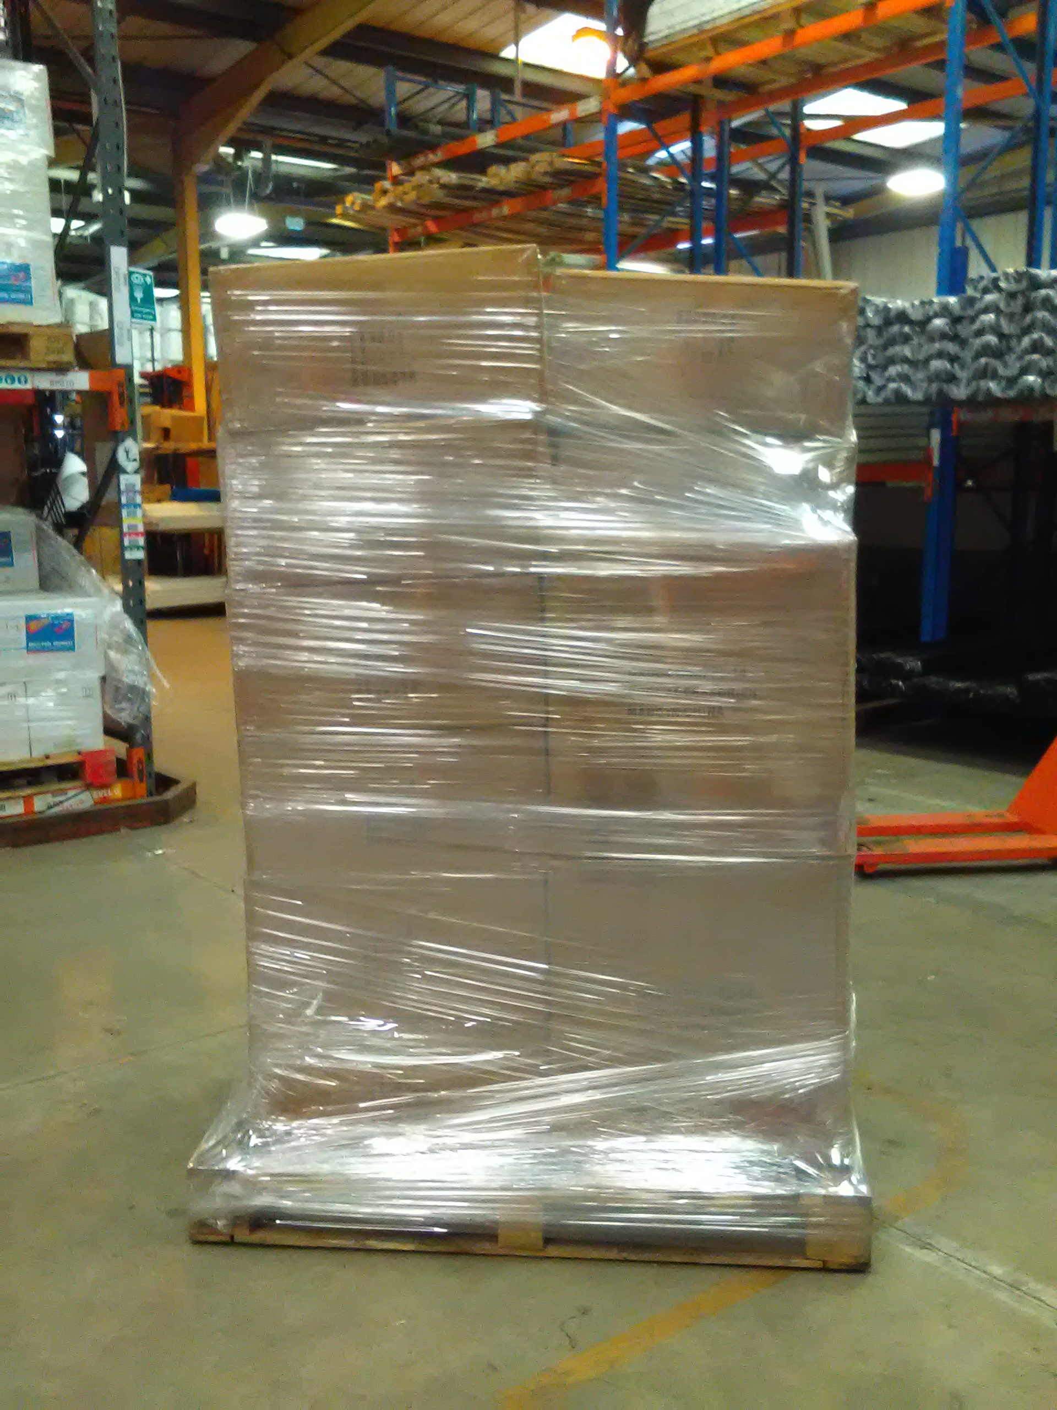
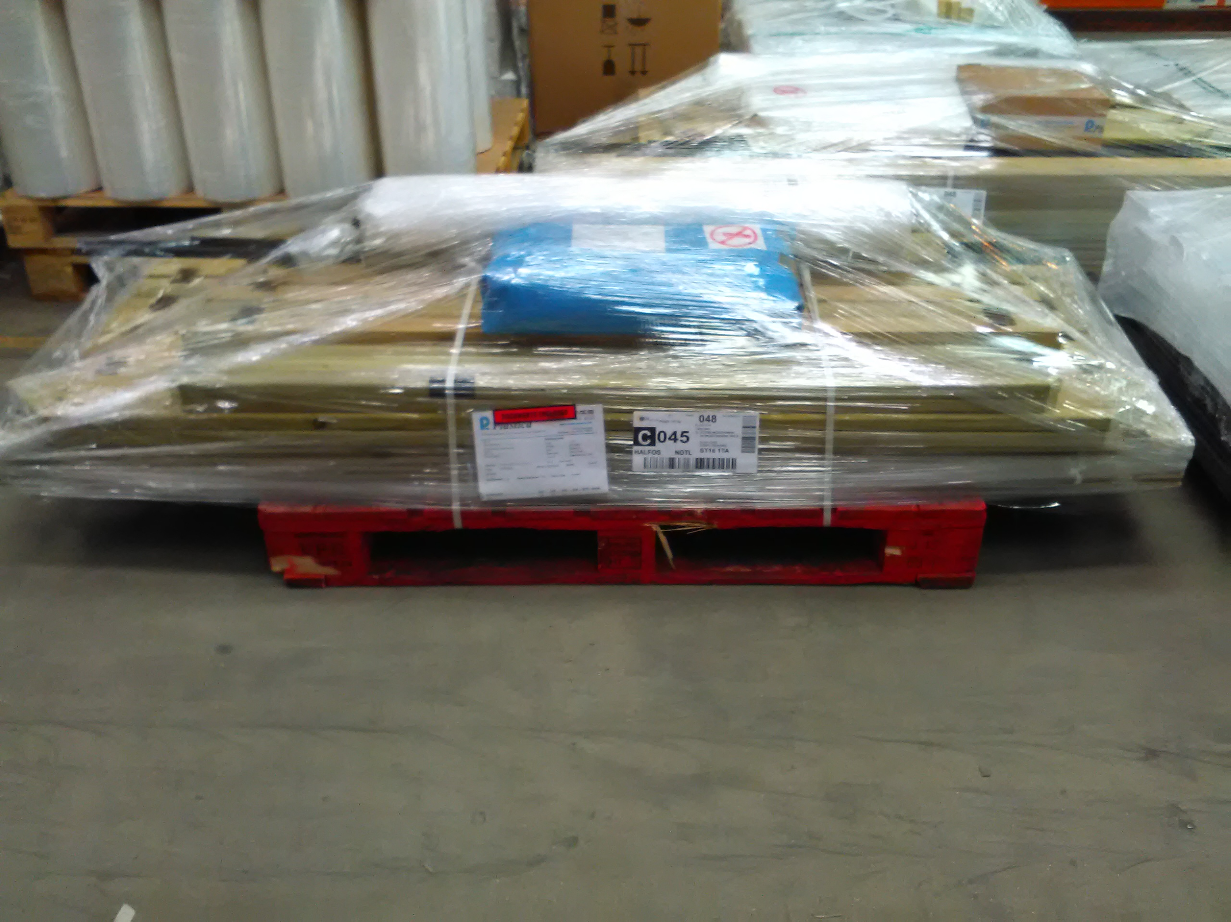
Stacking of a pallet
When stacking a pallet always have the heavy items on the bottom,
Keep the items within the foot print of the pallet ( this may vary for ponds and sandpits)
Do not go over 2meter high
Hazardous labels facing outwards and certain chemicals kept separate on the pallets ( training to be given)
A well wrapped pallet ,
Shrink wrap covering base of pallet going to the top of items
secure and tight
A pallet exceeding the pallet foot print

Slide 4
Movement of load in transit
Loads may move for a number of reasons whilst in transit
Bad loading
Movement of load against the bed of the vehicle due to oil, water, grit
badly stacked pallets
bad driving – hard braking –accelerating to fast
strapping not used or not secure enough to hold the load
uneven roads
Non Road worthy vehicle

Slide 5
Loading pallets on to a vehicle
Check the vehicle is serviceable and fit for purpose .
The bed of the lorry should be free from loose debris ,fluids, it should have no loose or broken flooring ,report if there is a problem
Find out if a FLT can be driven on to the rear before doing so
The hand brake should be applied and the keys handed over to the loader
Drivers must wear hi Viz and safety shoes
Once loaded driver should apply straps if needed ,this is down to the drivers discretion ,however if the loader is unsure please make someone aware .

Slide 6
Placement of loads on vehicles under the drivers advice. If unsure always talk to the driver . Evenly distribute weight accordingly , rules for overhanging items
When loading a lorry think about weight ,length, height of load.
Spread the weight out evenly across the bed of the lorry or according to the weight of the pallet . examples on page 7,8
Try to place high pallets next to the headboard or in between a pallet of similar Hight
If the load in longer than the bed of the lorry ,long load requirements may need to be applied as follows
Not exceeding 1 metre – no marker requirement
More than 1 meter but not exceeding 2 metre – end to be clearly visible with warning marker
More than 2 meter but not exceeding 3.05 metre - End and side marker boards required

Slide 7
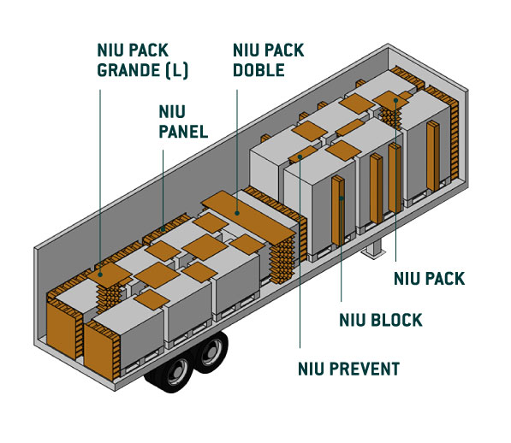
Examples of evenly distributed loads with void packaging and dunnage used
Nui is void packaging
Use of dunnage in between loads to stop movements
Dunnage used to stop movement

Slide 8
Examples of evenly distributed loads with void packaging and dunnage used

Slide 9
Unloading a vehicle
Allow the driver time to prepare the vehicle for unloading
Driver to hand over keys to the vehicle
Once the vehicle is ready and driver is out the way start unloading
If the load looks unstable or unsafe do not unload ( seek advice)
Unloading a vehicle can be dangerous THINK safety first
Examples below

Slide 10
Unloading
Care must be taken when opening cargo doors and curtains or before slackening any straps , ropes , or chains
Look for any tell tale signs that the load may have moved – bulging curtains , loose restraints
The load may have moved during transportation and may be in an unstable condition

Slide 11
Are these loads safe

Slide 12
Are these loads safe

Slide 13
SUMMERY
REMEMBER
The way a vehicle is loaded is crucial to preventing death or injury to the driver any passengers other road users and site staff

Slide 14
who is responsible for unsafe loads
Legal Action can be taken against the below people .
THE DRIVER
THE LOADER
THE TRANSPORT OPERATER AND LOADING COMPANY
EVERYONE INVOLVED OWES A DUTY OF CARE
Sign …………………………………………………………..
Print………………………………………………………….
Date………………………………………………………….

